Slide 1
SCILAB2C
Progress Report
Raffaele Nutricato
Atmel and PoliBa

Slide 2
What we have done so far:
State of the art analysis of the Matlab2C tools: “Catalytic” and “mcc compiler”.·
Definition of the SCILAB2C requirements/limitations: complex numbers, SCI2C library, annotations, etc.
Development of a toy application written in C using a SCI2C style.
Definition of the structure to store all the info concerning SCI2C functions.

Slide 3
Development of a toy application written in C using a SCI2C style.
A toy application (simulation of a guitar string) has been developed.
It is available in the hArtes web site. You can find a:
Matlab version: it is a complete version of the algorithm. Plot/Sound commands and additional information are available in this version.
Scilab version: this version is similar to the Matlab version, but all the plot/sound/display commands have been removed. Annotations have been added to the code to make possible a 100% conversion of the Scilab code into C code in a SCI2C style.
C Version: it is the C version of the Scilab code. The conversion has been done by taking into account how the SCILAB2C tool will operate (SCI2C style). In order to have a C version very close to the SCI2C style we have used the tree generated by the macr2tree Scilab function.

Slide 4
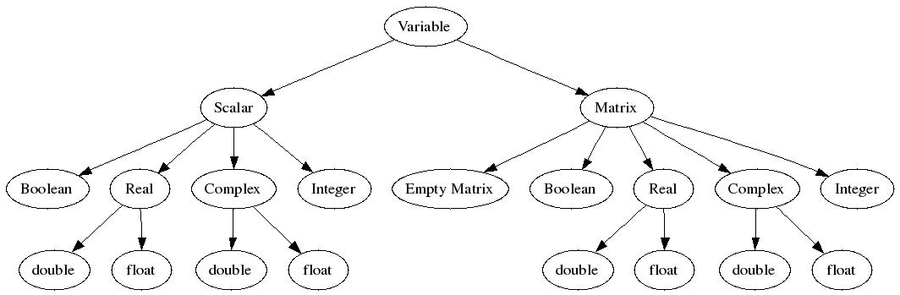
Definition of the structure to store all the info concerning SCI2C functions.
SCI Code
1 tree per SCI function
Multiple C functions per SCI function
The tree has been implemented by using SCILAB tlist type
AST
sin(variable)
C function
C function
C function
C function
C function
C function
C function
C function

